Slide 1
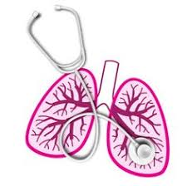
University of Basrah Al-zahraa medical college
Ministry of higher Education and Scientific Researches
The module: Respiratory System
Module staff:
Dr. Amer Qasim
Dr. Majid Hameed
Dr. Nawal Mustafa
Dr. Hadeel Salman
Dr. Luma Ahmed
Dr. Kadhum Salih
Dr. Ihsan Mardan
Dr. Firas Muhammed

Slide 2
University of Basrah Al-zahraa medical college
Ministry of higher Education and Scientific Researches
Oxygen in the blood
The main functions of respiratory system are:
To provide a constant supply of oxygen (O2) to keep your body cells functioning.
To remove carbon dioxide (CO2) from the body cells.

Slide 3
University of Basrah Al-zahraa medical college
Ministry of higher Education and Scientific Researches
Oxygen is transported both physically dissolved in blood and chemically combined to the haemoglobin in the erythrocytes (RBC).
The solubility coefficient of O2 = 0.01 mmol/L /kPa at 37°C, therefore:
normal arterial blood with a of approximately 100 mm Hg contains only about 0.003 mL O₂/mL of blood, or 0.3 mL O₂/100 mL of blood.
Much more oxygen is normally transported combined with haemoglobin than is physically dissolved in the blood.

Slide 4
University of Basrah Al-zahraa medical college
Ministry of higher Education and Scientific Researches
The delivery of oxygen by arterial blood to the tissues of the body has a number of critical determinants including blood oxygen concentration (content), saturation (SO2) and partial pressure, haemoglobin concentration and cardiac output.

Slide 5
University of Basrah Al-zahraa medical college
Ministry of higher Education and Scientific Researches
The oxygen concentration (usually termed “oxygen content”) of systemic arterial blood depends on several factors, including the partial pressure of inspired oxygen, the adequacy of ventilation and gas exchange, the concentration of haemoglobin and the affinity of the haemoglobin molecule for oxygen.

Slide 6
University of Basrah Al-zahraa medical college
Ministry of higher Education and Scientific Researches
The content (or concentration) of oxygen in arterial blood (CaO2) is expressed in mL of oxygen per 100 mL or per L of blood, while the arterial oxygen saturation (SaO2) is expressed as a percentage which represents the overall percentage of binding sites on haemoglobin which are occupied by oxygen. In healthy individuals breathing room air at sea level, SaO2 is between 96% and 98%

Slide 7
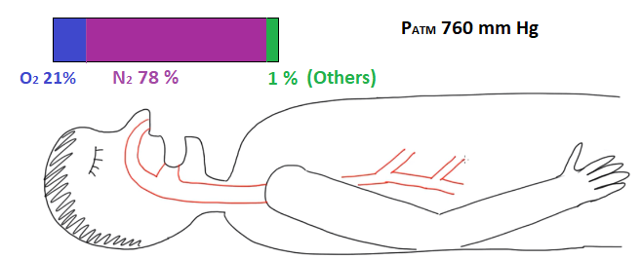
University of Basrah Al-zahraa medical college
Ministry of higher Education and Scientific Researches
The partial pressure of oxygen
Outside of the body
The gases in the air
Fraction of Inspired of Oxygen = FIO2 = 0.21
PO2 = 0.21 × 760 mm Hg = 160 mm Hg (outside of the body)

Slide 8
University of Basrah Al-zahraa medical college
Ministry of higher Education and Scientific Researches
Inside of the body
The partial pressure of oxygen will change as the air goes inside the body because the vapor of water, at 37 ͦC the vapor pressure = 47 mm Hg
PO2 = 0.21 ×( 760 - 47) mm Hg = 150 mm Hg (inside of the body)
(outside the Alveolar)

Slide 9
University of Basrah Al-zahraa medical college
Ministry of higher Education and Scientific Researches
The partial pressure of oxygen inside alveolar will be :
pO2 = 150 -50 = 100 mm Hg or PAO2 = 100 mm Hg
Delivery of O2 to tissues
DO2 = CO × CaO2
where :
DO2:Delivery of oxygen
CO : Cardiac output
CaO2 : The content of the arterial blood

Slide 10
University of Basrah Al-zahraa medical college
Ministry of higher Education and Scientific Researches
CO (ml/m)= SV (b/m) × HR (b/m)
SV : stroke volume (SV)
HR : heart rate (HR)
SV: is the volume of blood pumped from the left ventricle per beat.
CaO2 = 1.34 × [Hgb] × SaO2 + ( 0.003 × PaO2)

Slide 11
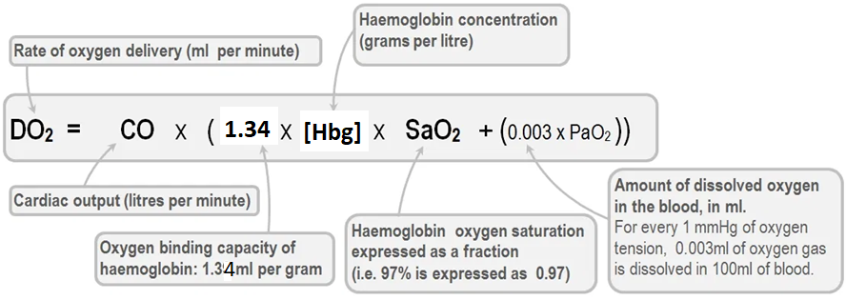
University of Basrah Al-zahraa medical college
Ministry of higher Education and Scientific Researches
This equation display the amount of oxygen which delivery to the tissues
and can be separated to three parts:
First Part : how much blood pumping ( Cardiac output)
Second Part: how much oxygen binds with haemoglobin. (1.39 × [Hbg]) × SaO2)
Third Part : how much oxygen (dissolved )diffuse down into plasma (0.003 × PaO2)

Slide 12
University of Basrah Al-zahraa medical college
Ministry of higher Education and Scientific Researches
Example: Calculate the Oxygen delivery for the patient
with the following the information.
SV = 100 m/b (b:beat, m : minute)
HR = 185 b/m
Hgb = 15 g
SaO2 = 80 %
PaO2 = 50 mm Hg
DO2 = CO × CaO2
CO = SV × HR
= 100 (m/b)× 185 (b/m) =18500 ml/m or 18.5 L/m

Slide 13
University of Basrah Al-zahraa medical college
Ministry of higher Education and Scientific Researches
CaO2 = 1.34 × Hbg × SaO2 + 0.003 × PaO2
= 1.34 × 15 × 0.80 + 0.003 × 50
= 16.08 + 0.15
(Oxygen combined to Hbg) + (Oxygen dissolve in plasma)
CaO2 = 16.23
therfore
DO2 = 18.5 × 16.23
= 300.255 ml O2/ mim

Slide 14
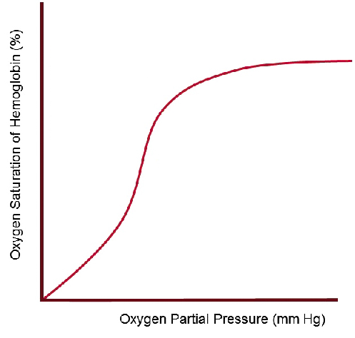
University of Basrah Al-zahraa medical college
Ministry of higher Education and Scientific Researches
Oxygen-Haemoglobin Dissociation Curve
The relationship in blood between oxygen saturation (SO2) and partial pressure (pO2) is described graphically by the oxygen–haemoglobin dissociation curve. (sigmoid (s­shaped))
Y -axis is represent the percentage
of oxygen that
bonds to haemoglobin

Slide 15
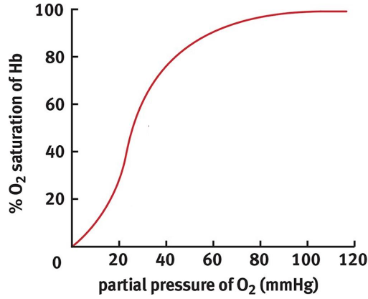
University of Basrah Al-zahraa medical college
Ministry of higher Education and Scientific Researches
In this curve two main areas
can be represented
First , about ( 0 to 60) mm Hg of PAO2.
As the PaO2 increase the SaO2 % increase
Second ( 60 and above) plateau phase, the change in PaO2 will not change SaO2

Slide 16
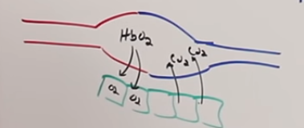
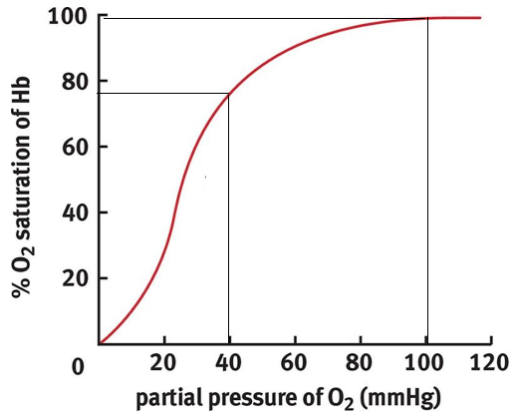
University of Basrah Al-zahraa medical college
Ministry of higher Education and Scientific Researches
At normal situation
98 %
78 %
98 % SaO2
arterial blood
Tissue
PaO2 40 mmHg
78 % SaO2
Venous blood
unload oxygen for tissues cells equal to =
98 % - 78 = 20 %
systemic venous blood
PaO2 (100) in lung
Systemic arterial blood
PaO2 (40) at tissue (restating)

Slide 17
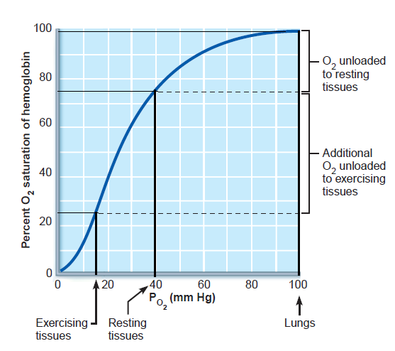
University of Basrah Al-zahraa medical college
Ministry of higher Education and Scientific Researches
Exercise ( some metabolic)
Increase:
H⁺
BPG
CO2
Temp.
O₂ dissociation
98 % SaO2
arterial blood( lung)
25 % SaO2
Venous blood (Exercise )
unload oxygen for tissues cells equal to = 98 % - 25 = 73 %

Slide 18
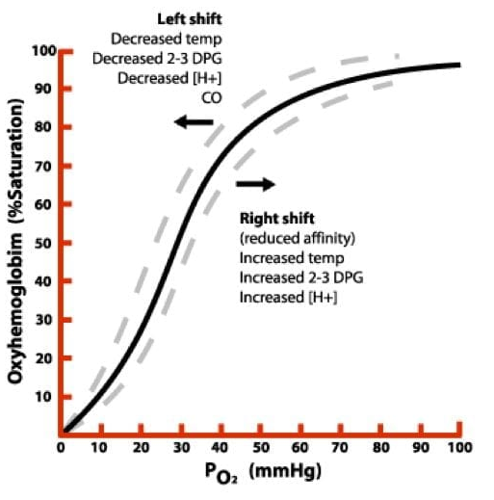
University of Basrah Al-zahraa medical college
Ministry of higher Education and Scientific Researches
Bohr Effect
Oxygen-Haemoglobin curve demonstrates the saturation of haemoglobin by oxygen under normal conditions.
Carbon dioxide lowers the pH of the blood (by forming carbonic acid), which causes haemoglobin to release its oxygen.
This is known as the Bohr effect – a decrease in pH shifts the oxygen dissociation curve to the right.

Slide 19
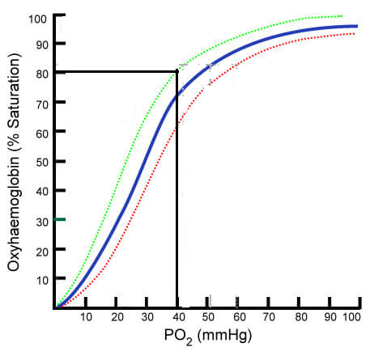
University of Basrah Al-zahraa medical college
Ministry of higher Education and Scientific Researches
decrease:
H⁺
2,3-BPG
CO₂
Temp.
O₂ affinity
Haldane effect
decrease O₂ dissociation
Bohr effect
Increase:
H⁺
2,3-BPG
CO₂
Temp.
O₂ affinity
increase O₂ dissociation

Slide 20
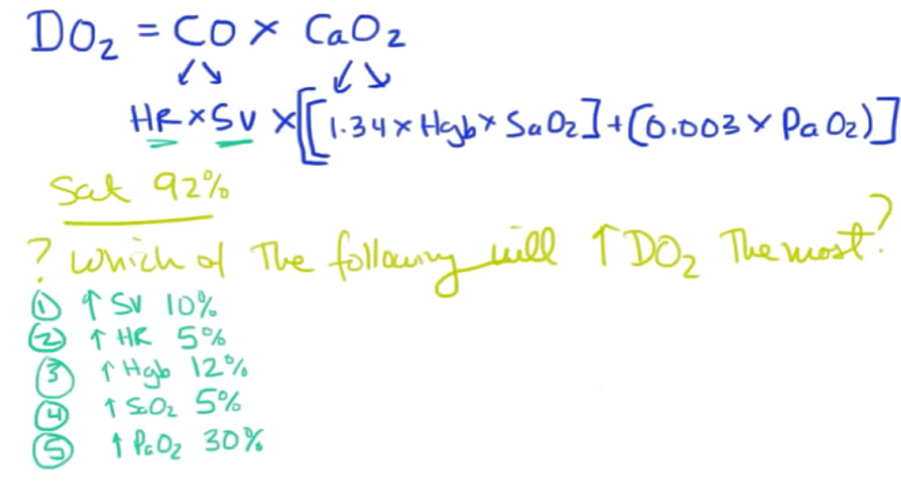
University of Basrah Al-zahraa medical college
Ministry of higher Education and Scientific Researches

Slide 21
University of Basrah Al-zahraa medical college
Ministry of higher Education and Scientific Researches
Thanks

